Slide 1
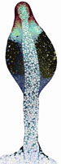
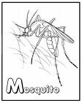
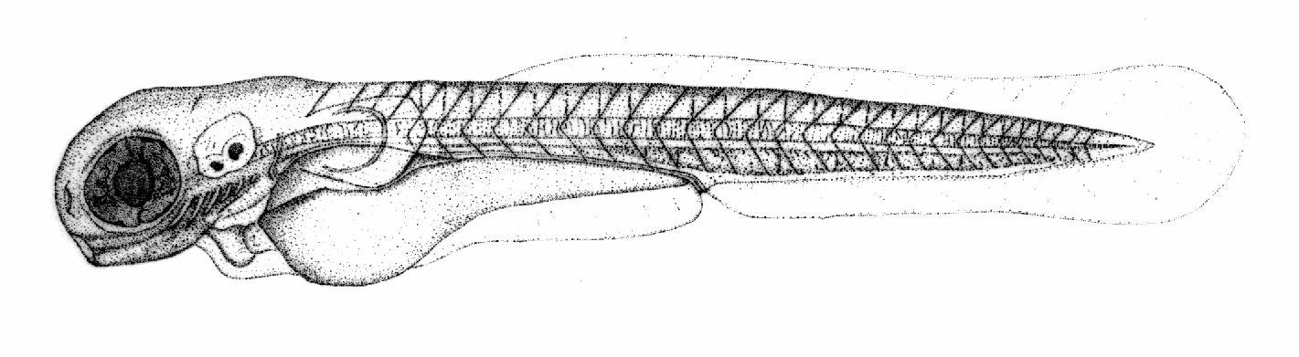
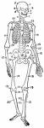
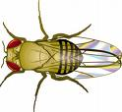



Ontology Community
Melissa Haendel

Slide 2
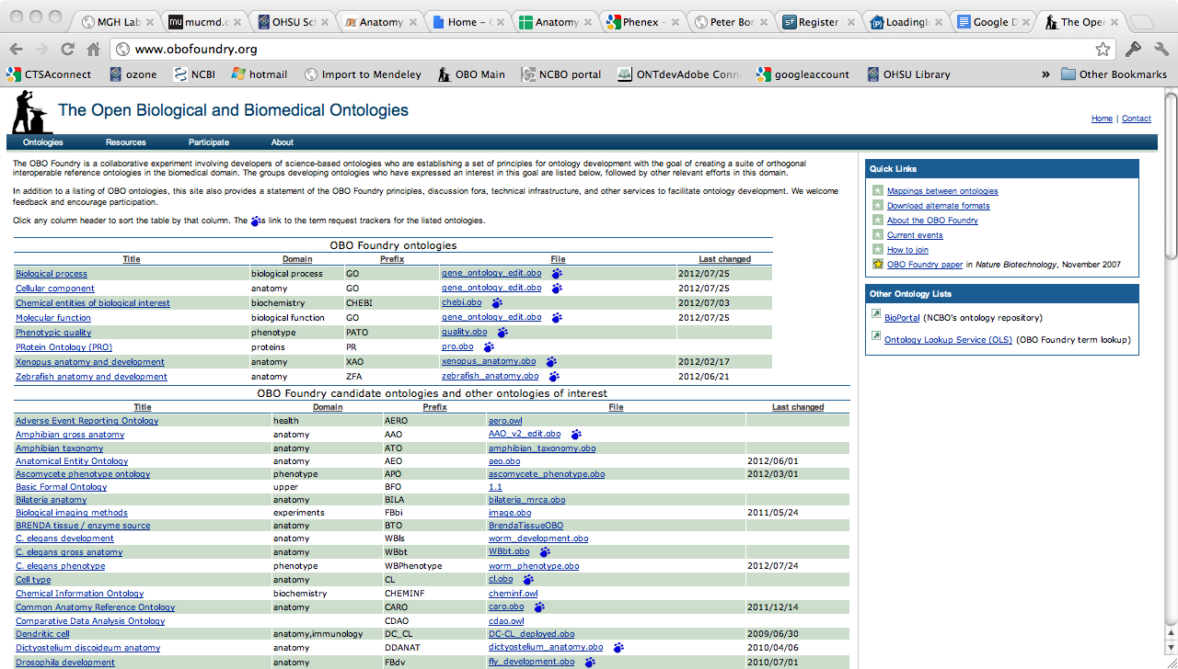
The OBO Foundry
http://www.obofoundry.org/
More than just a website, it’s a community of ontology developers dedicated to working together using common principles

Slide 3
OBO Foundry Listserves
The anatomy ontology community has a large number of listeserves to coordinate collaborative efforts. A list of lists is:
http://www.obofoundry.org/cgi-bin/discussion.cgi
The most relevant ones are:
https://lists.sourceforge.net/lists/listinfo/obo-discuss
https://lists.sourceforge.net/lists/listinfo/obo-anatomy
https://lists.sourceforge.net/lists/listinfo/obo-cell-type
https://lists.sourceforge.net/lists/listinfo/obo-phenotype
Note that most of these are fairly low traffic, and these are archived

Slide 4
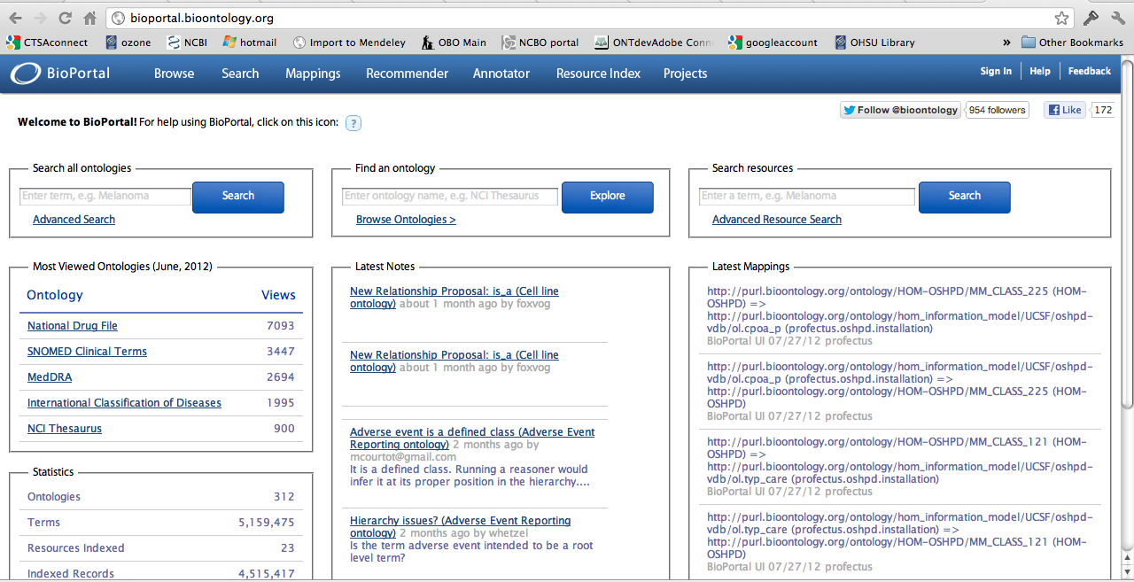
Bioportal
http://bioportal.bioontology.org/
A library of ontologies and ontology related services

Slide 5
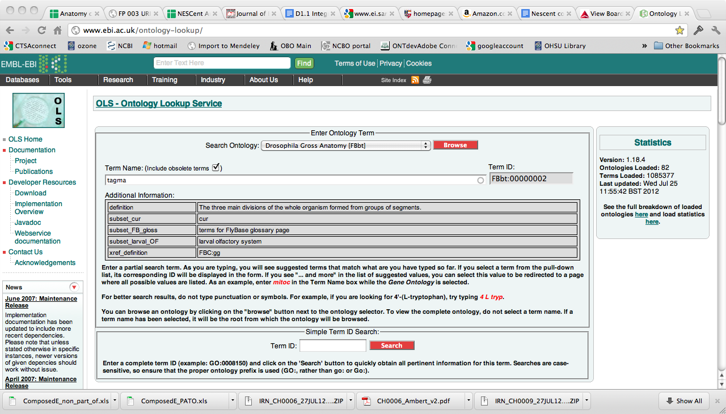
Ontology Lookup Service
http://www.ebi.ac.uk/ontology-lookup/

Slide 6
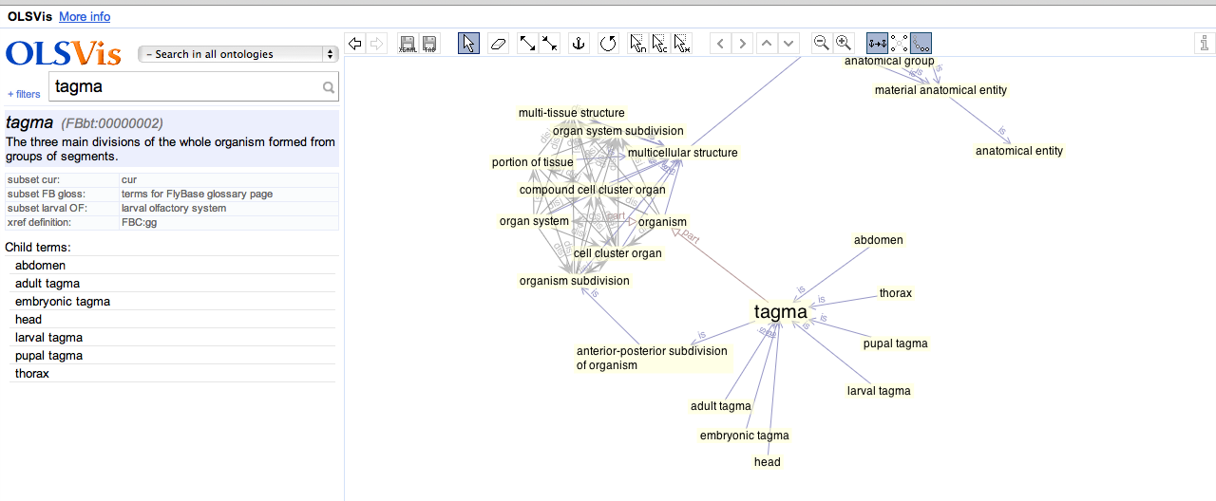
Ontology Lookup Service
Query and visualize OBO ontologies
http://ols.wordvis.com/

Slide 7
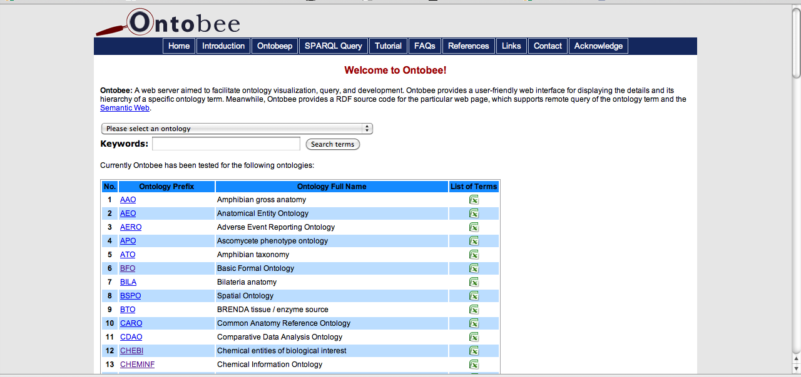
Ontobee
http://www.ontobee.org/
Query OBO ontologies, and provides RDF supporting remote query of each ontology term and the Semantic Web

Slide 8
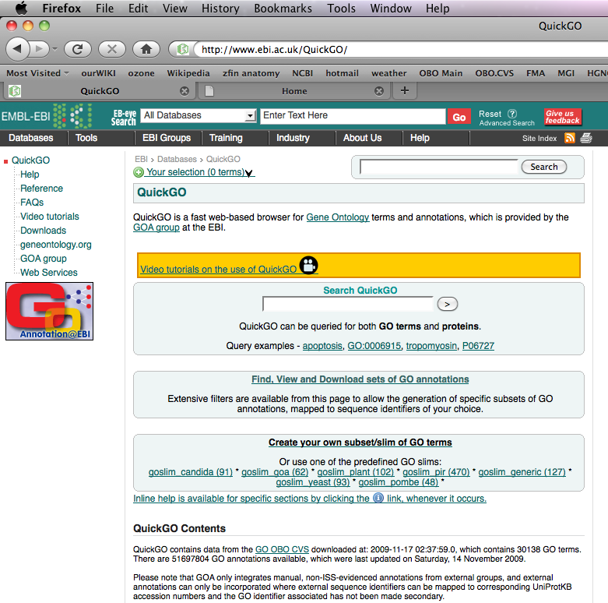
QuickGO at the EBI
http://www.ebi.ac.uk/QuickGO/

Slide 9
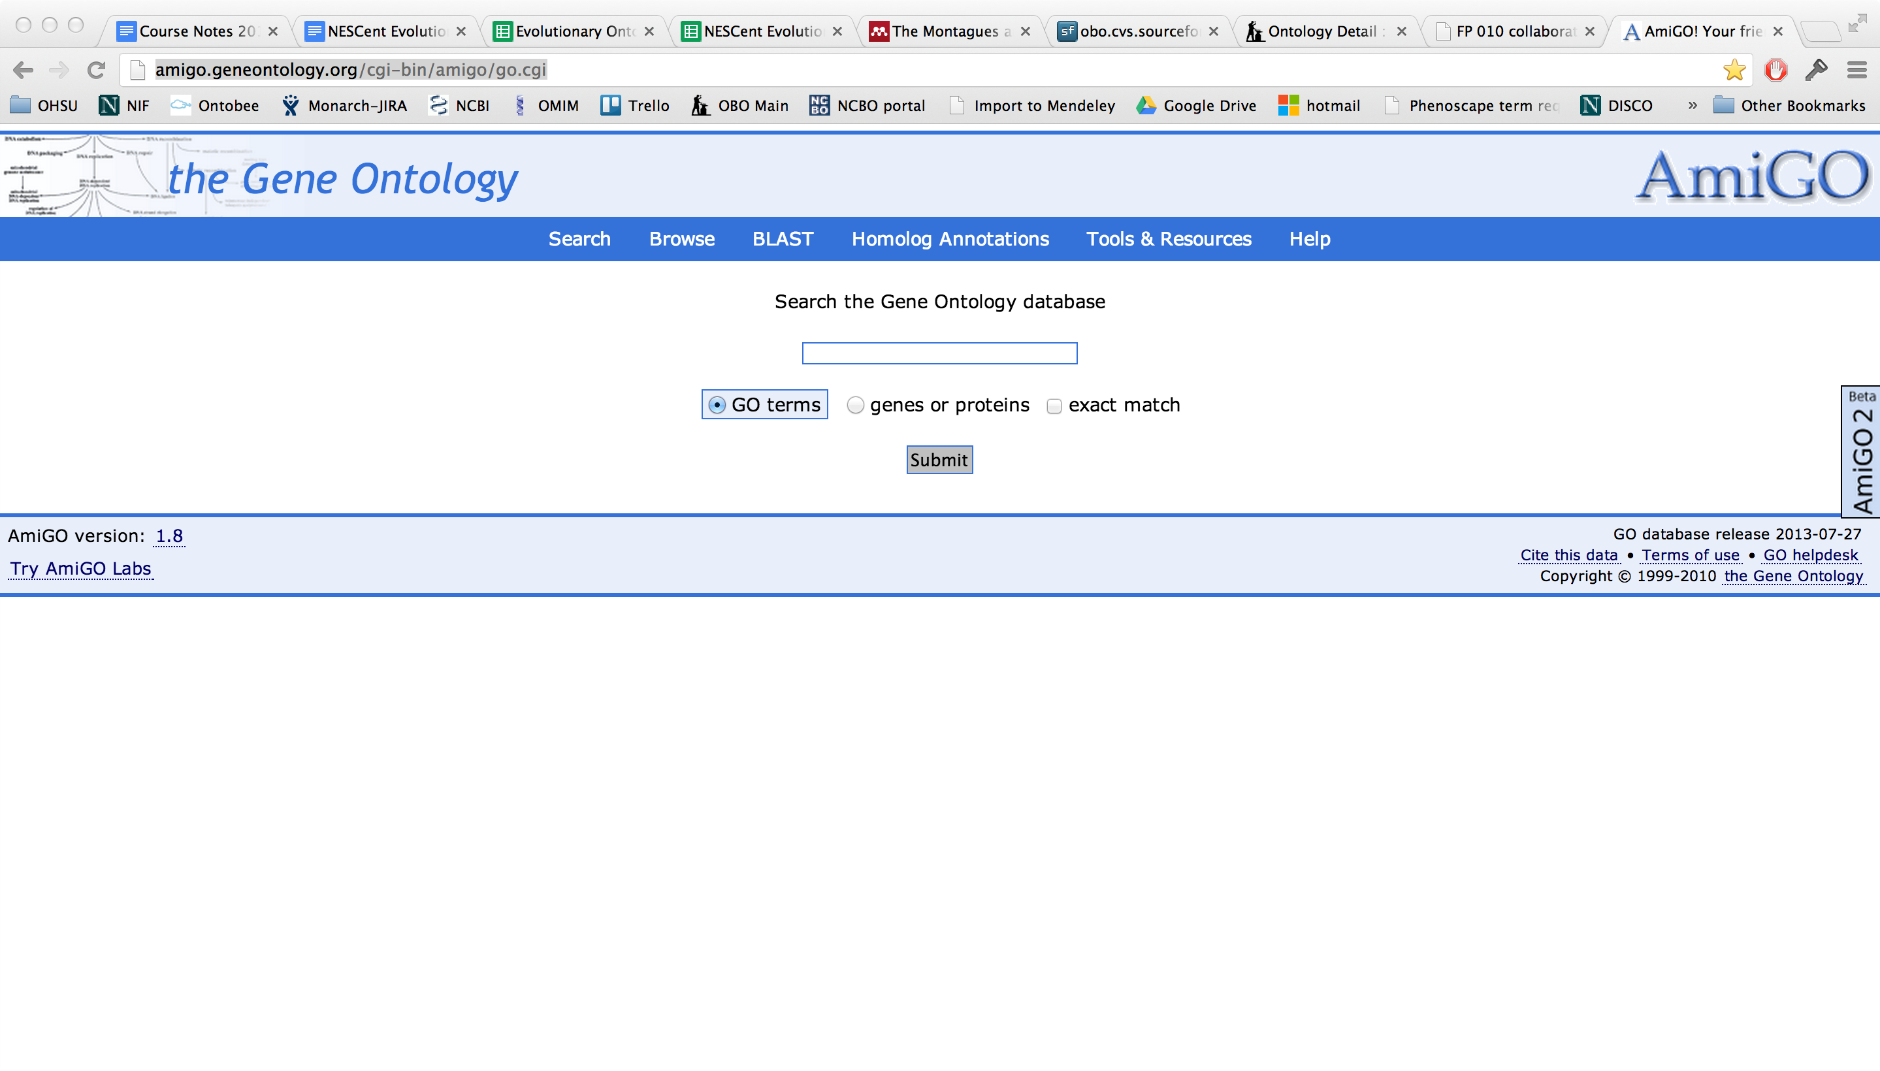
AmiGO
http://amigo.geneontology.org/

Slide 10


Two ontology editors and their development and user communities
OBOEdit- OBO ontology editor and viewer
http://oboedit.org/
OBO-Edit Working Group
geneontology-oboedit-working-group@lists.sourceforge.net
Bugs should be reported here:
http://sourceforge.net/tracker/?group_id=36855&atid=418257
Protégé - OWL ontology editor and viewer
http://protege.stanford.edu/
Protégé user group:
https://mailman.stanford.edu/mailman/listinfo/protege-owl
Protégé 4.X feedback:
https://mailman.stanford.edu/mailman/listinfo/p4-feedback
Notes:
Do we have this slide in matt’s talk?

Slide 11
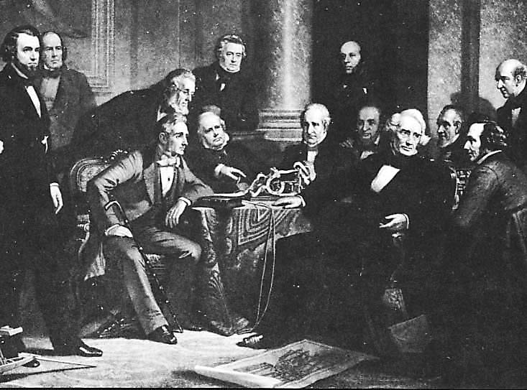
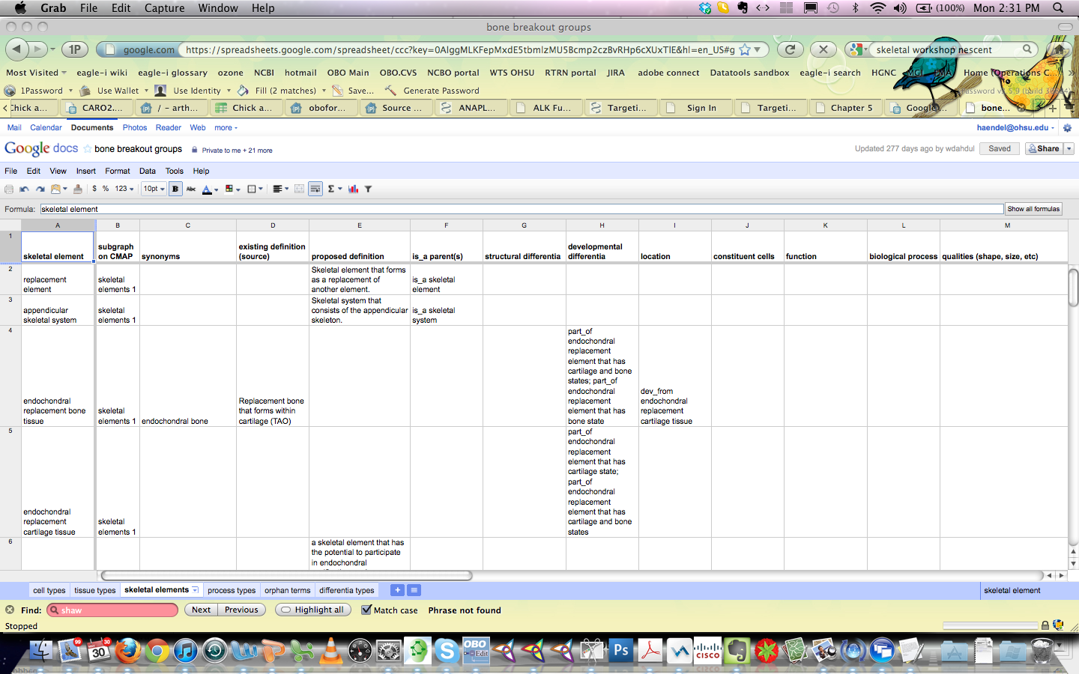
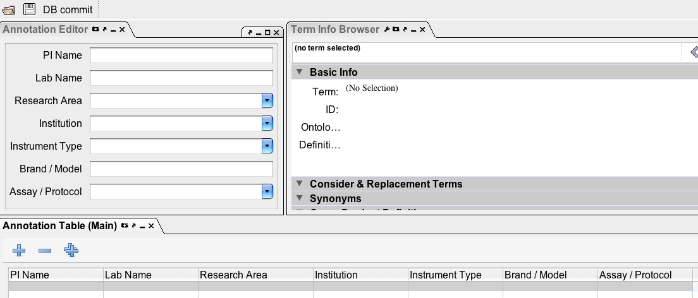

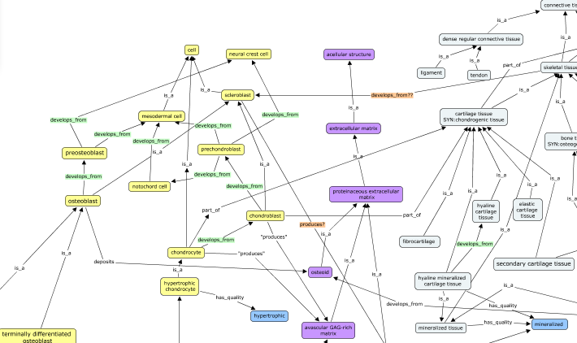
Mechanisms of extracting knowledge from domain experts
http://www.phenote.org/
1862 Christian Schussele
Familiar tooling: Google docs, Phenote, Excel
Visualization: Cmap, Vue, GraphViz

Slide 12
What is a tracker?
A tracker is a place to put a formal ontology request.
Trackers have long been used in the software community for keeping track of bugs, feature requests, etc.
In the ontology community, they are quite valuable because they provide a documented, structured requests for changes or additions.
Tracker IDs can be referenced in ontology metadata- such as in an editor note or definition annotation.

Slide 13
How do you write a tracker request?
It is important that when you make a tracker request, you provide as much information as possible, in order to facilitate the change you are requesting and future reference
For new terms, or term rearrangements, provide the intended hierarchy – both SubClass as well as any other relations required (such as partonomy)
Provide text definitions, that make sense in the Genus Differentia context, for all new or edited terms
Provide attribution for the definitions
Some commentary may occur on the tracker item, but can sometimes lead to long listserve discussions before returning to a decision on the tracker
Complex issues requiring decision are best first discussed on the listserves or in design documents, but its always better to say something somewhere!

Slide 14
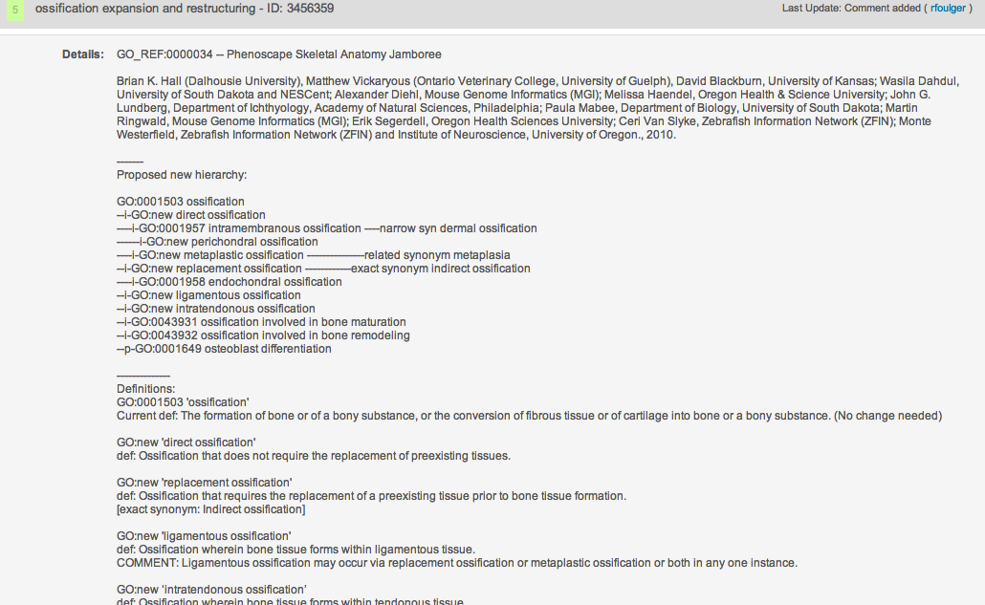
Example tracker request
https://sourceforge.net/tracker/index.php?func=detail&aid=3456359&group_id=36855&atid=440764

Slide 15
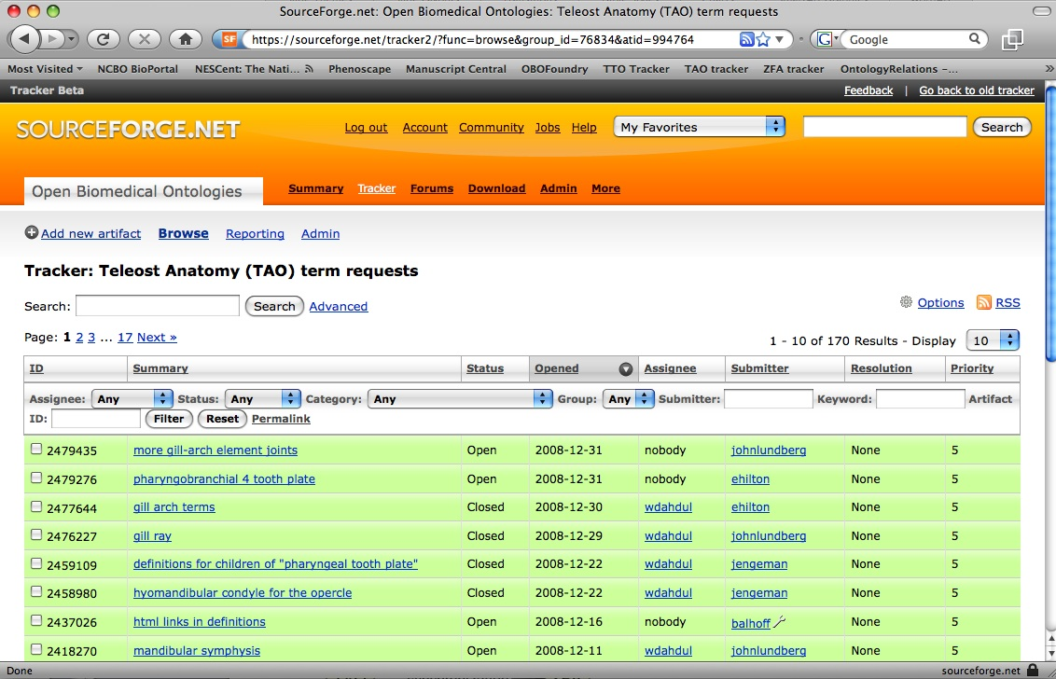
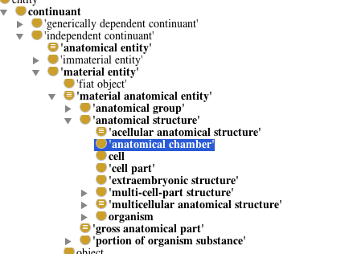
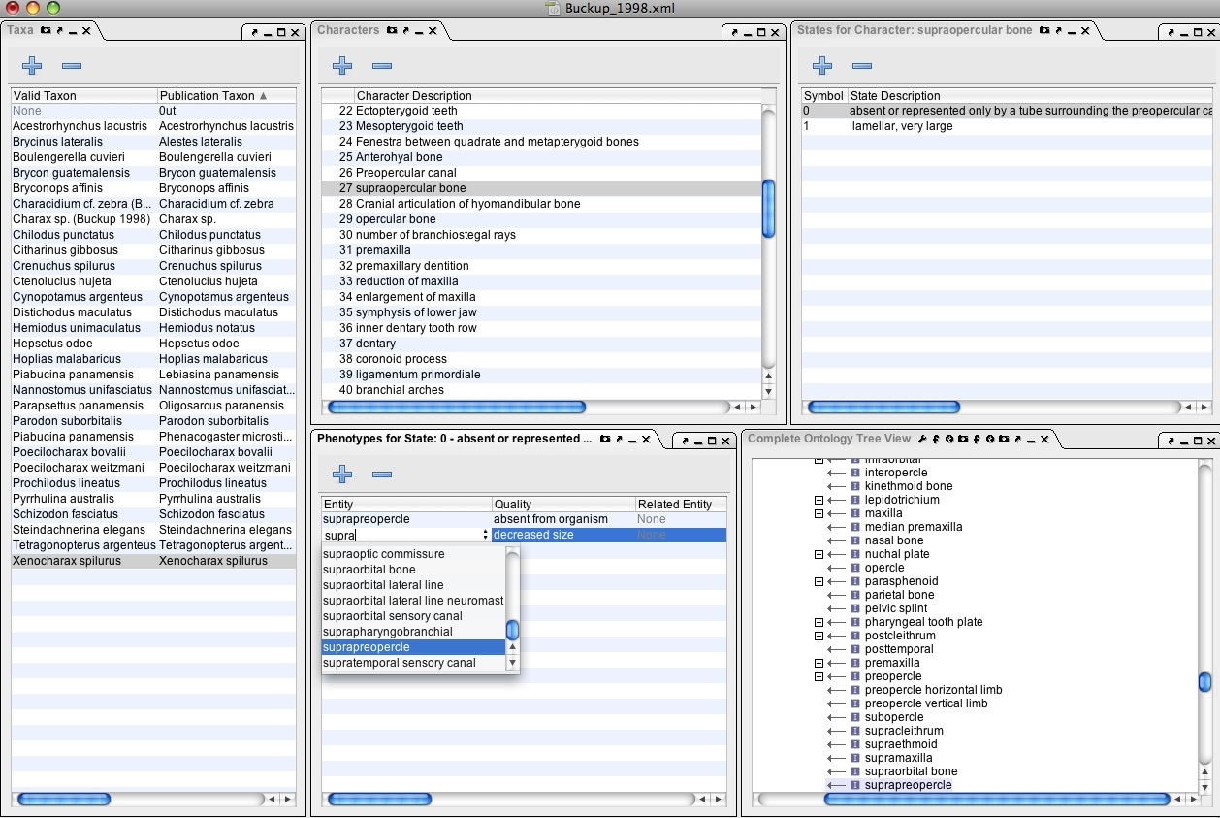
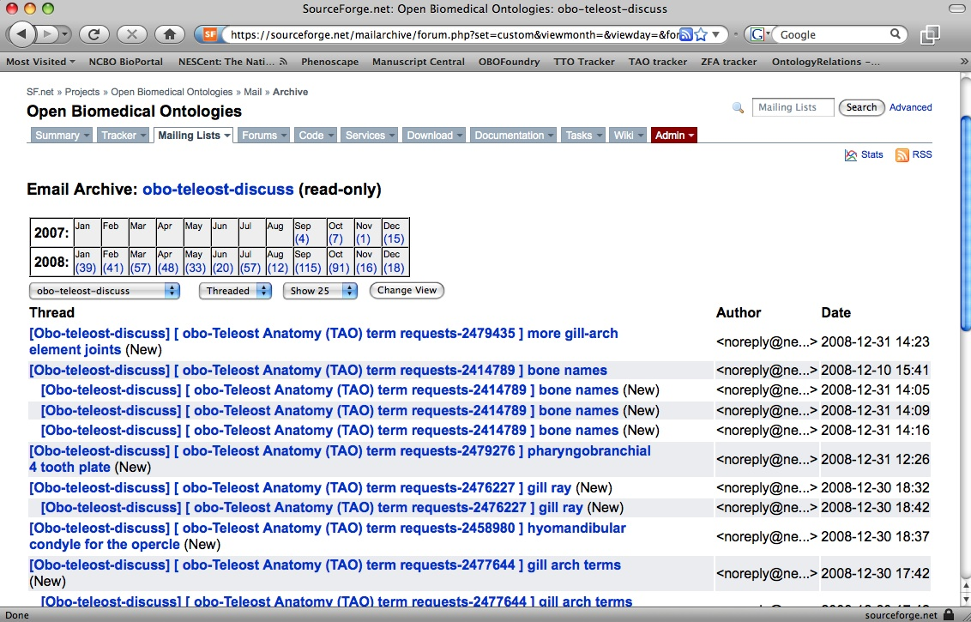
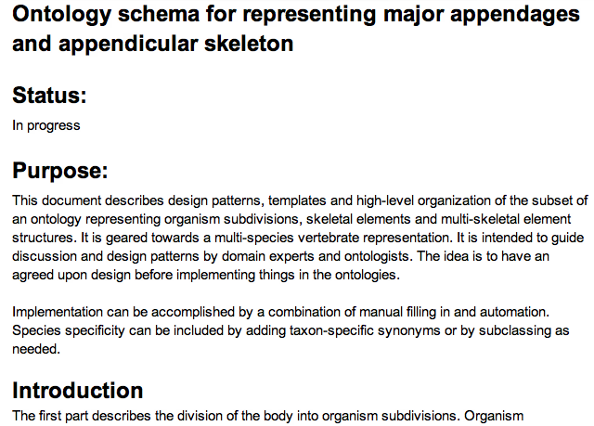
Lists, trackers, ontologies, annotation, oh my!
Ontology Edited
Tracker IDs can be in ontology metadata
Term requested
Trackers are often autoemailed to integrated listserves
Term brokers are being developed to create temp classes during ontology editing or annotation
Design documents comment on existing ontologies
Term discussed by community
Term needed for annotation
Design and requirements analysis
Notes:
Add design documents

Slide 16

Your work affects others
Anatomy ontologies have very overlapping content
We can reuse common design patterns gaining us:
Interoperability
Ease of implementation
Quality reasoning power
Decreased duplicative effort
It is likely nothing you do in an ontology will remain siloed - eventually it will matter in the greater context
GO
MP
UBERON
CARO
MA
AAO
TAO
XAO
ZFA
CL

Slide 17
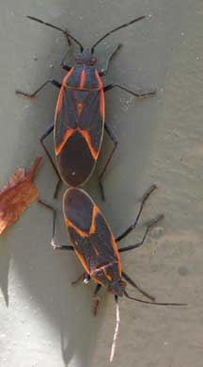
Feeling the love?
http://www.whatsthatbug.com/2008/07/05/mating-boxelder-bugs/

